Slide 1
Team Project Final Milestone
Group 1:
Team Members:
Chaithanya Reddy Bogadi - 013803998
Naga Sindhu Korlapati - 012467832
Nandini Puppala - 013752713
Prathusha Koouri - 013710658
Sindhu Ravichandran - 013769821
Venkata Anil Kumar Thota - 012525734
CMPE257-Spring 2019

Slide 2
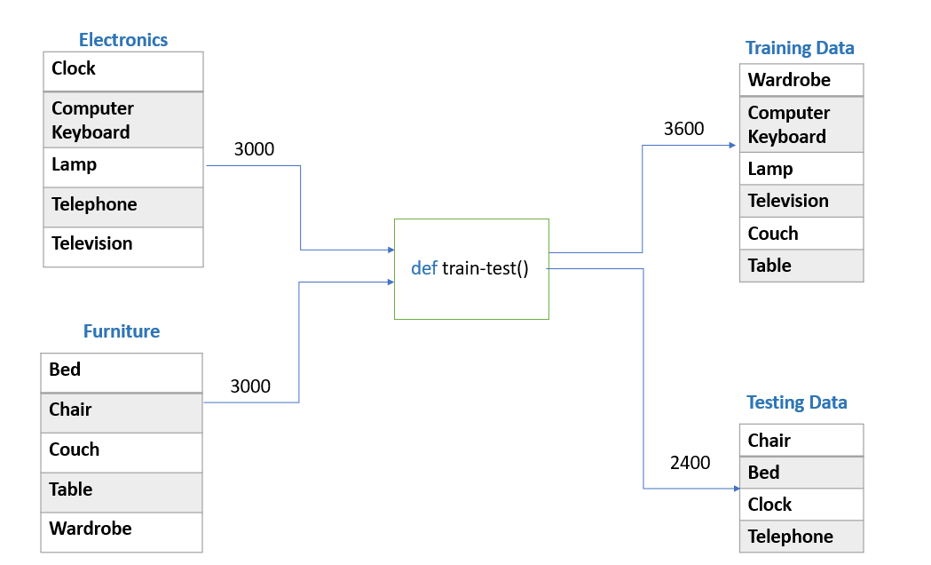
Data Preparation

Slide 3
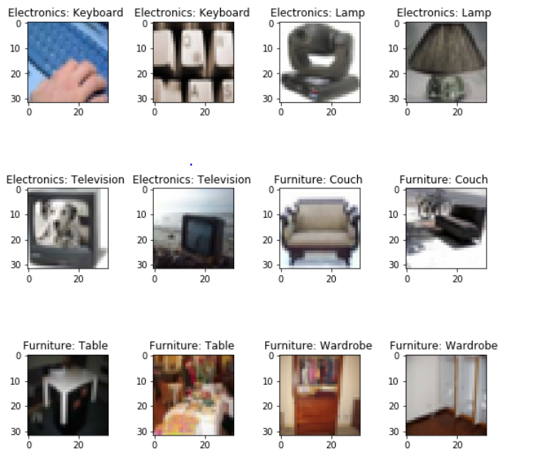
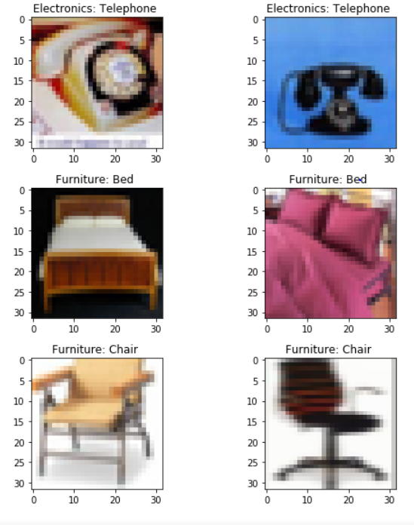
Validation Images
Train Data Test Data

Slide 4
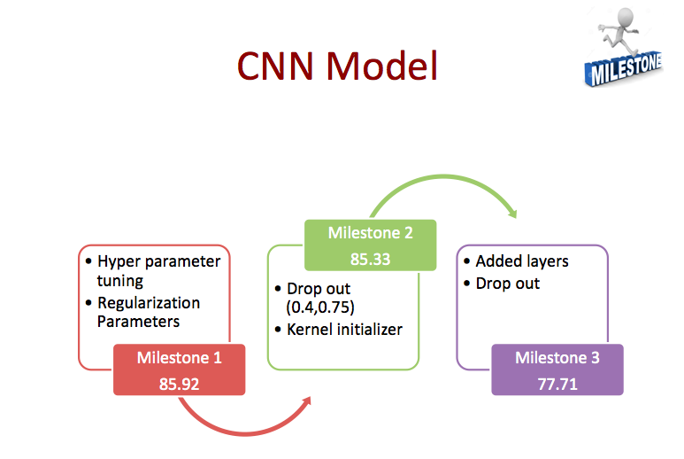

Slide 5
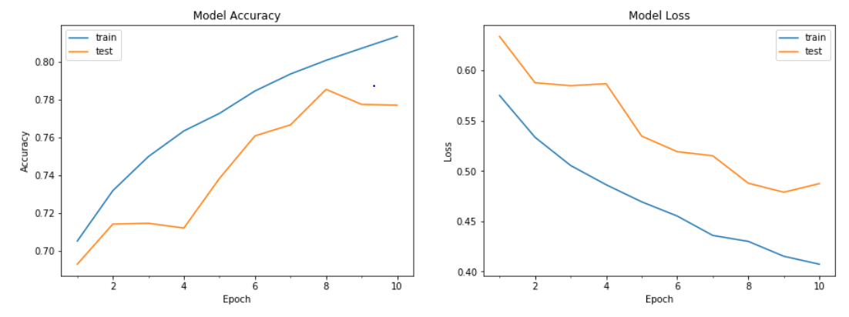
Best Model – CNN
Accuracy – 77.71% Labels = [Clock , Telephone, Chair, Bed]

Slide 6
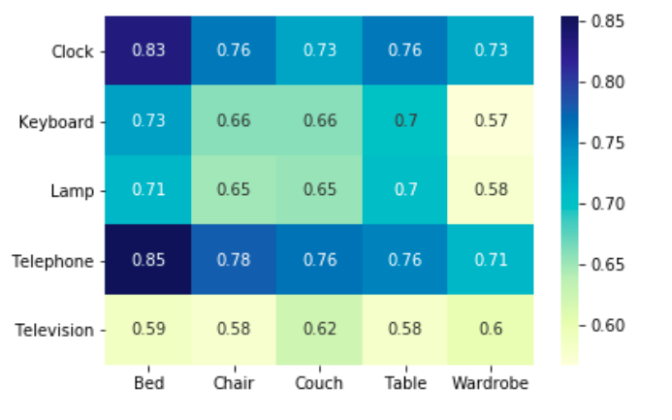
Heat Map of CNN model – Milestone 2

Slide 7
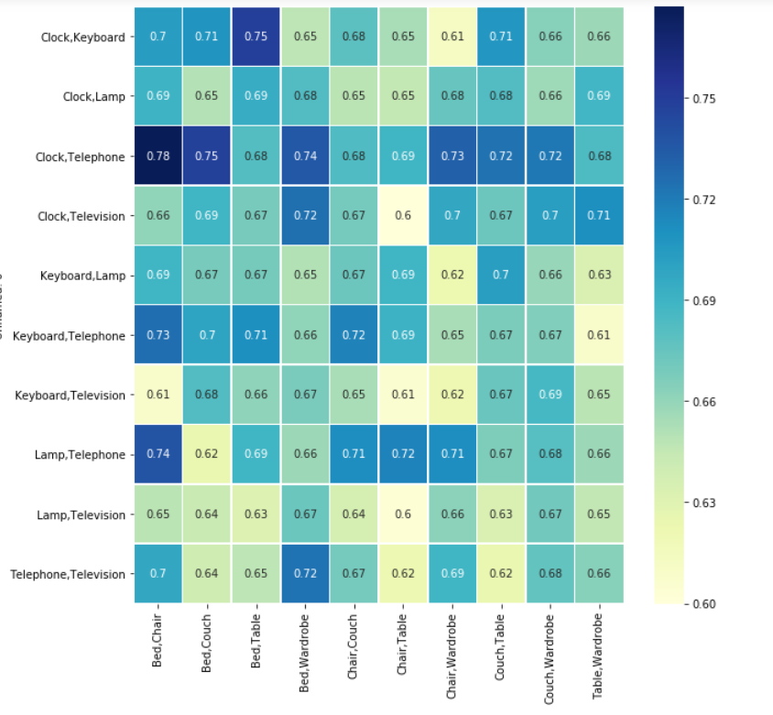
Heat Map of CNN model – Milestone 3

Slide 8
Confusion matrix
We have Considered:
Negative Class – Household Electronics
Positive Class – Household Furniture
True Negatives – 1052
True Positives – 813
False Negatives – 148
False Positives – 387

Slide 9
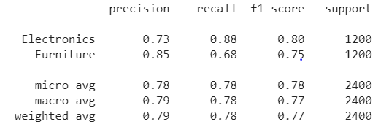
Classification Report

Slide 10
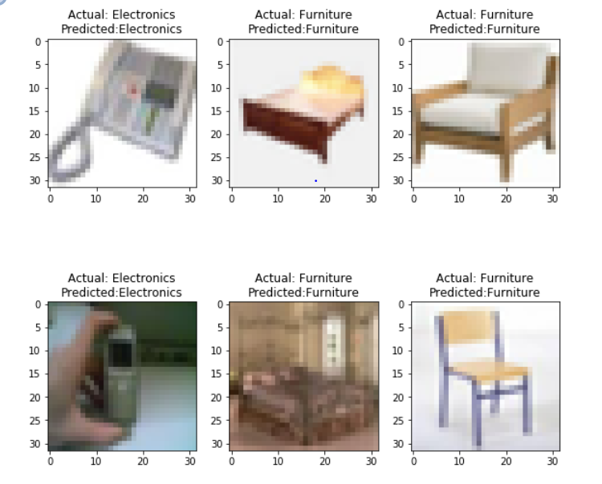
Predicted Images

Slide 11
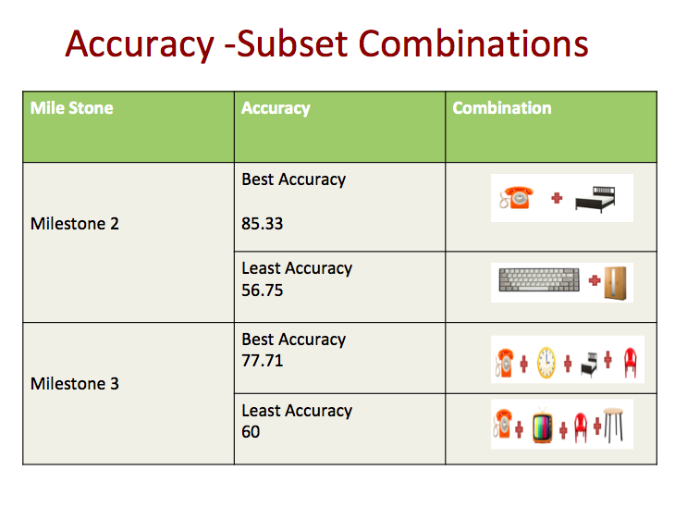

Slide 12
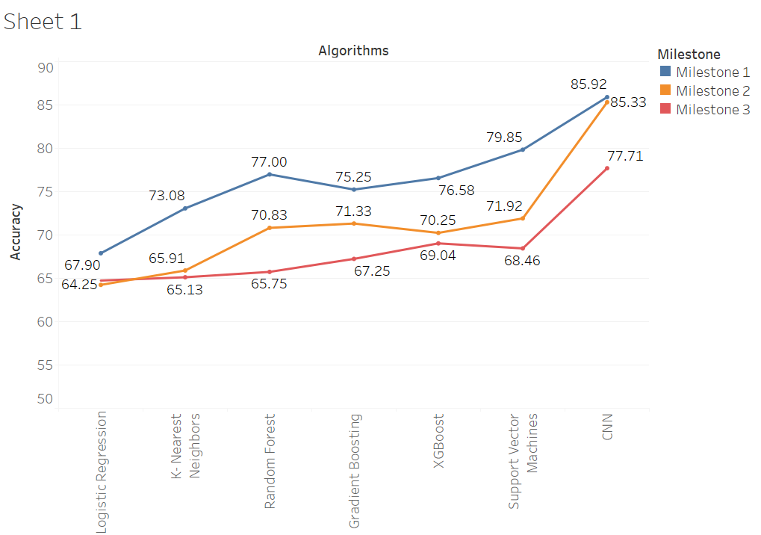
Accuracy in all Milestones

Slide 13


Algorithm | Min | Max | Average | Median | S.D | 25 Percentile | 75 Percentile
Logistic | 50.00 | 64.25 | 58.58 | 60.16 | 4.01 | 56.16 | 61.41
KNN | 41.41 | 65.91 | 56.96 | 57.91 | 6.19 | 54.75 | 61.41
Random Forest | 51.24 | 64.25 | 58.58 | 60.16 | 4.84 | 59.58 | 66.16
XGBoost | 53.42 | 70.25 | 63.05 | 64.67 | 5.07 | 59.92 | 66.25
Gradient Boosting | 55.00 | 71.33 | 63.50 | 64.66 | 4.20 | 61.33 | 66.16
SVM | 51.08 | 71.92 | 64.20 | 66.00 | 5.92 | 63.08 | 68.66
CNN | 56.75 | 85.33 | 69.01 | 69.83 | 8.19 | 62.33 | 75.50
Milestone2
Algorithm | Min | Max | Average | Median | S.D | 25 Percentile | 75 Percentile
Logistic | 53.37 | 64.75 | 58.24 | 58.16 | 2.54 | 56.41 | 60.01
KNN | 47.30 | 65.13 | 56.57 | 57.55 | 4.14 | 53.46 | 59.83
Random Forest | 52.00 | 65.75 | 58.05 | 58.04 | 2.81 | 55.69 | 59.95
XGBoost | 53.75 | 69.04 | 61.93 | 61.95 | 3.49 | 59.51 | 64.67
Gradient Boosting | 55.86 | 67.25 | 61.96 | 61.81 | 2.77 | 60.00 | 64.37
SVM | 54.04 | 68.46 | 62.28 | 63.08 | 3.58 | 59.81 | 64.92
CNN | 60.00 | 77.71 | 67.39 | 67.20 | 3.53 | 65.06 | 69.49
Milestone3

Slide 14
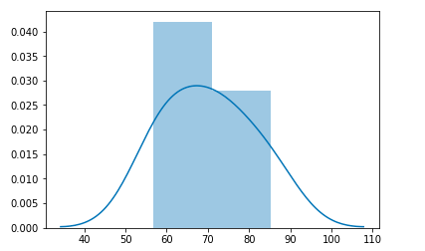
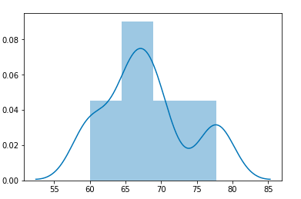
Distribution Plot for CNN
Milestone 2
Milestone 3

Slide 15
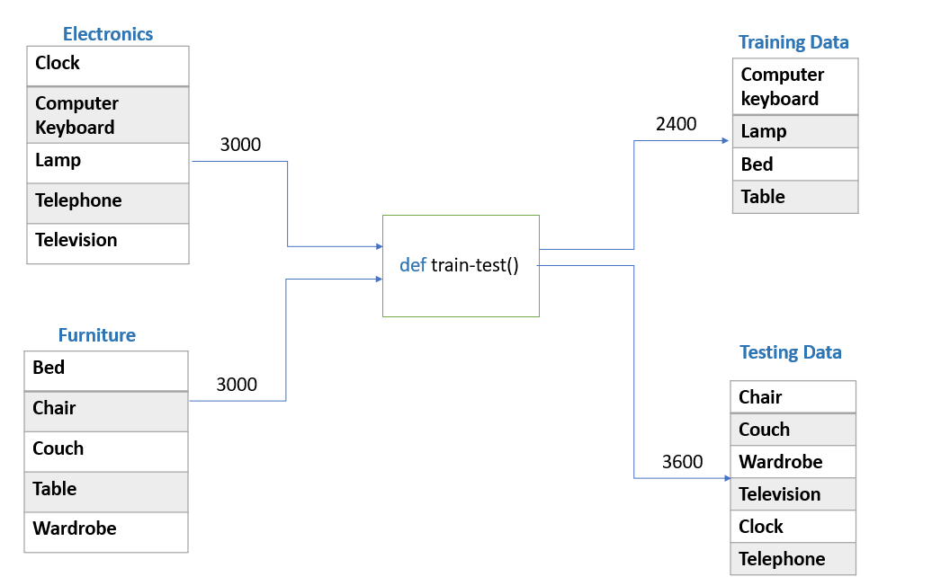
Data Preparation- Bonus

Slide 16
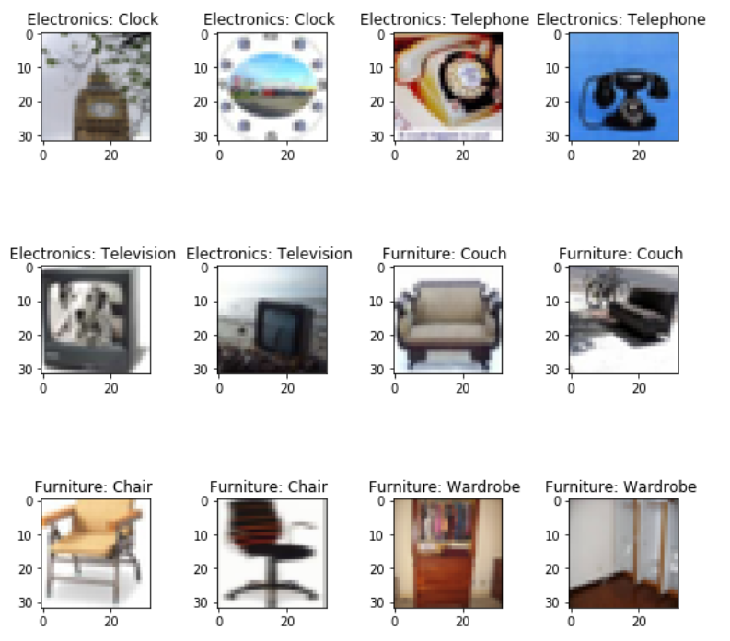
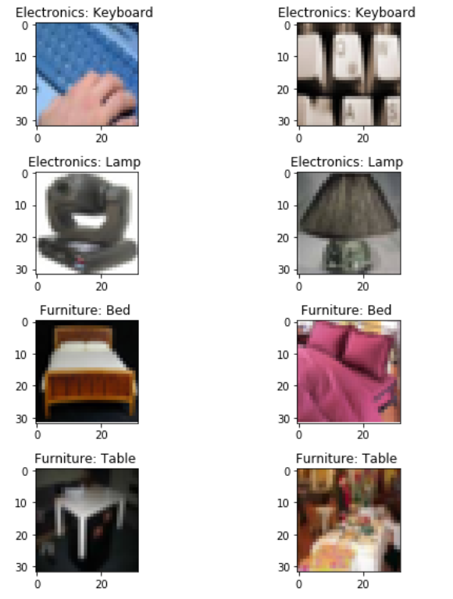
Validation Images
Train Data
Test Data

Slide 17
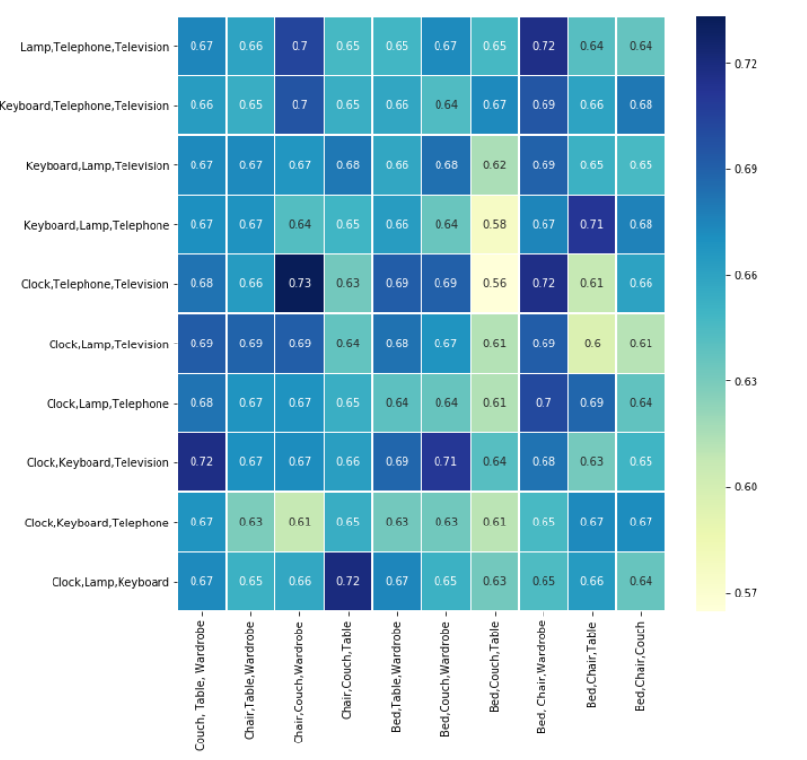
Min | Max | Average | Median | S.D | 25 Percentile | 75 Percentile
56.47 | 73.33 | 66.09 | 66.37 | 3.06 | 64.21 | 68.10

Slide 18
Lessons Learnt
•Working with RGB image data •Image Augmentation •Image Conversion to Gray Scale •GridSearchCV •Kernel, bias initialization •Model Save •Using GPU •Robust Model

Slide 19
THANK YOU

